Slide 1
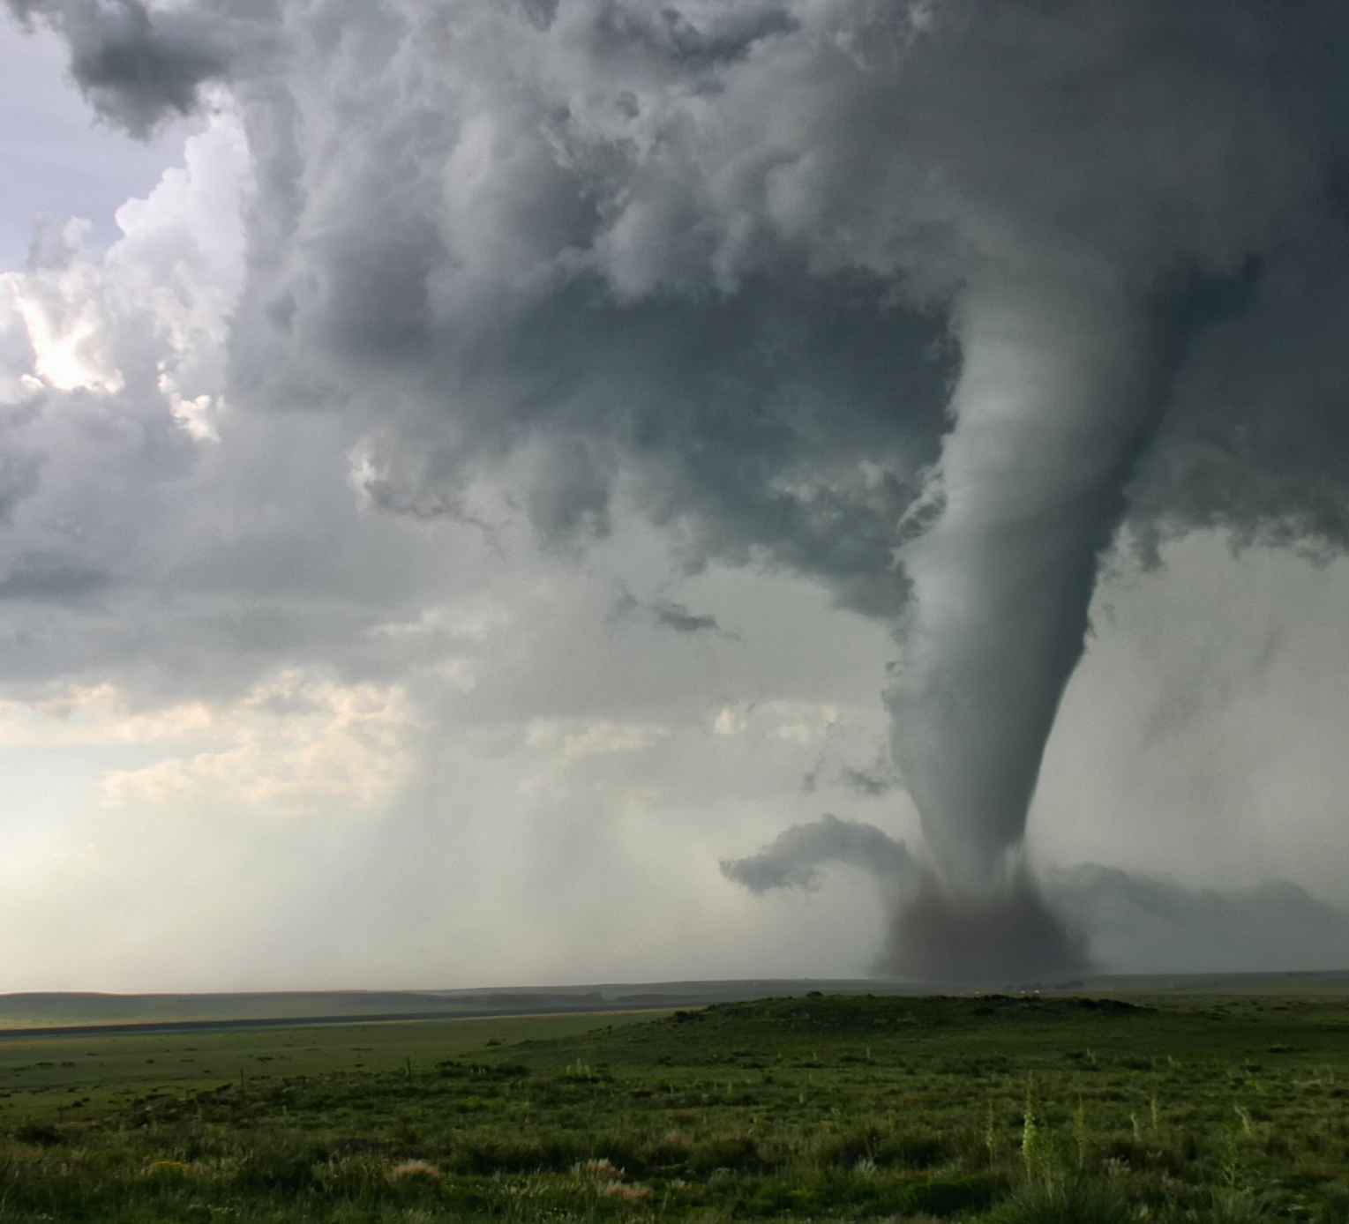
Changes Caused by the Weather
Chapter 5
Lesson 4

Slide 2
Questions!!!
Write a question for the following three words that could possibly be answered in today’s lesson.
Weather Habitats Landslides

Slide 3
Questions!!!
Turn to the person next to you and share your questions with each other.
If your question gets answered during our lesson today Miss. Swisher will give you a dollar!!

Slide 4
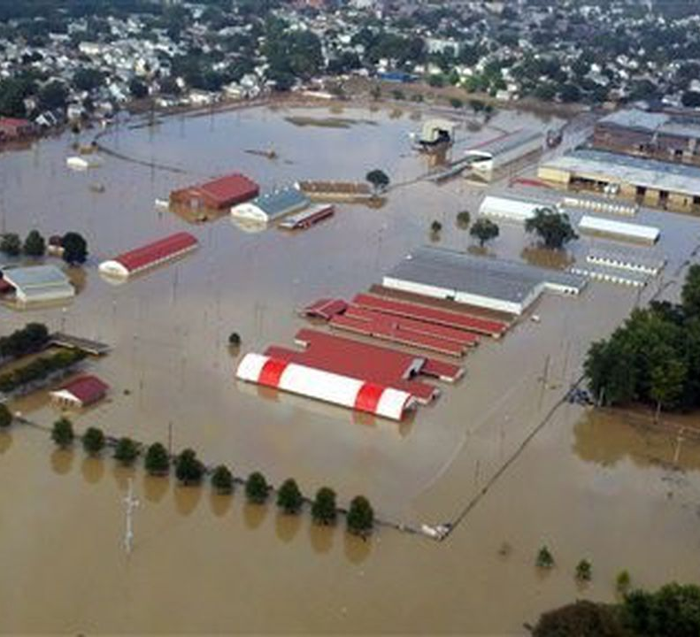
Floods
An overflow of water onto land that is normally dry is called a flood.
Floods sometimes even happen here in Bloomsburg.

Slide 5
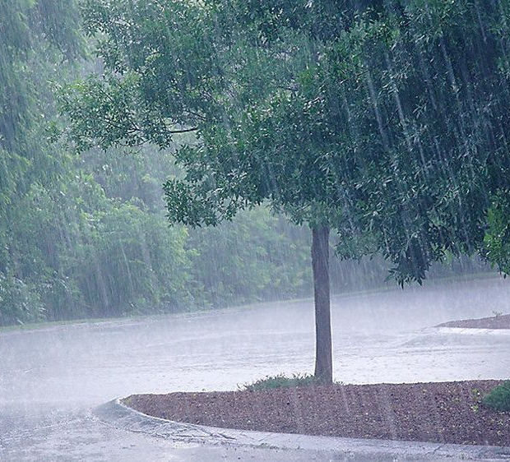
Causes of Floods Flood waters usually come from heavy rain or quickly melting snow.

Slide 6
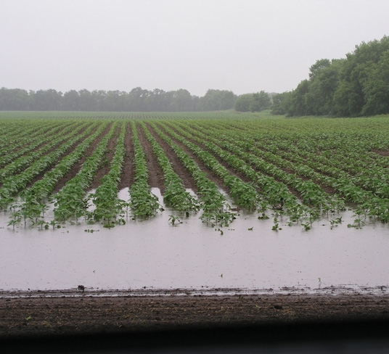
Affects of Floods
A flood can help the land by depositing rich soil on it.

Slide 7
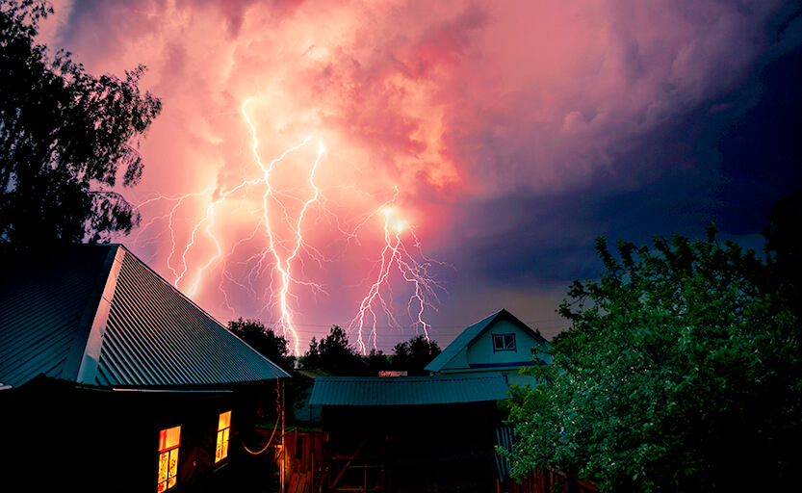
Fires
A fire can be caused by lightning or other natural sources.

Slide 8
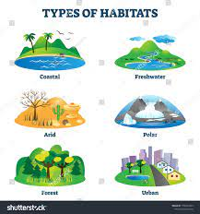
Habitats
Plants and animals may lose their habitats after a fire.
A habitat is a natural home or environment of a plant or animal.

Slide 9
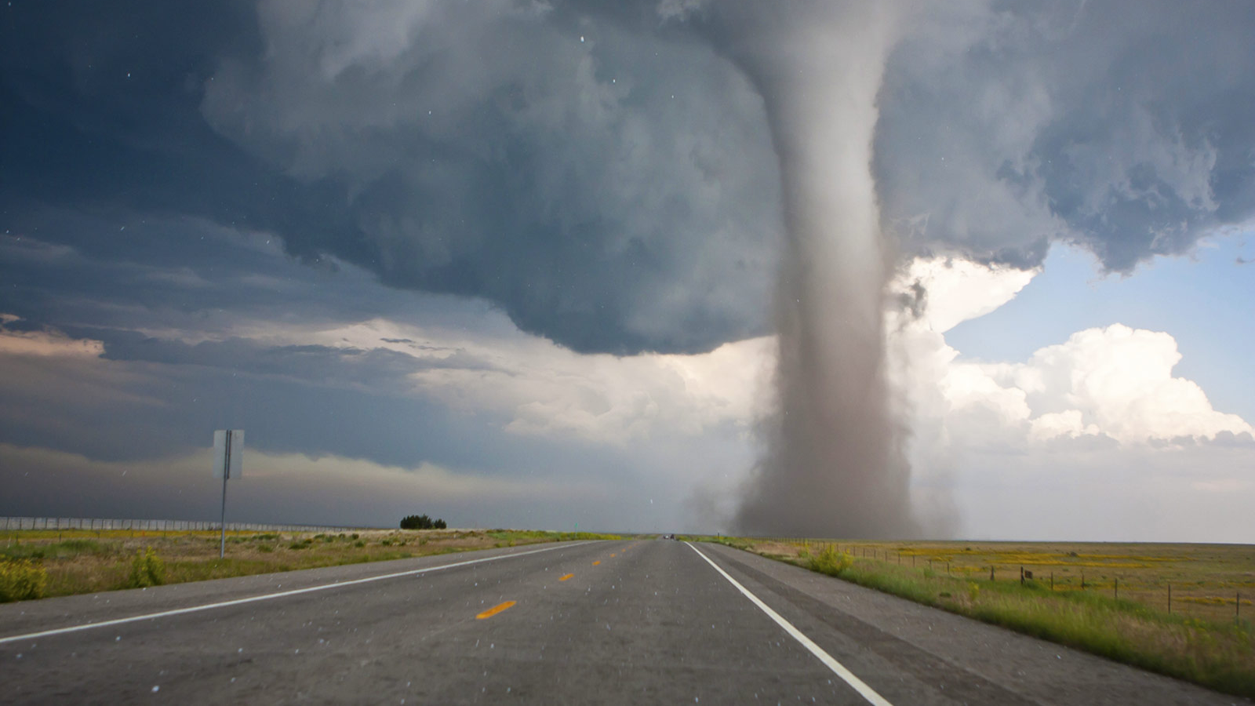
Tornado
The storm caused by a column of air that spins rapidly is called a tornado.
https://www.youtube.com/watch?v=RcZdg3I2Pso

Slide 10
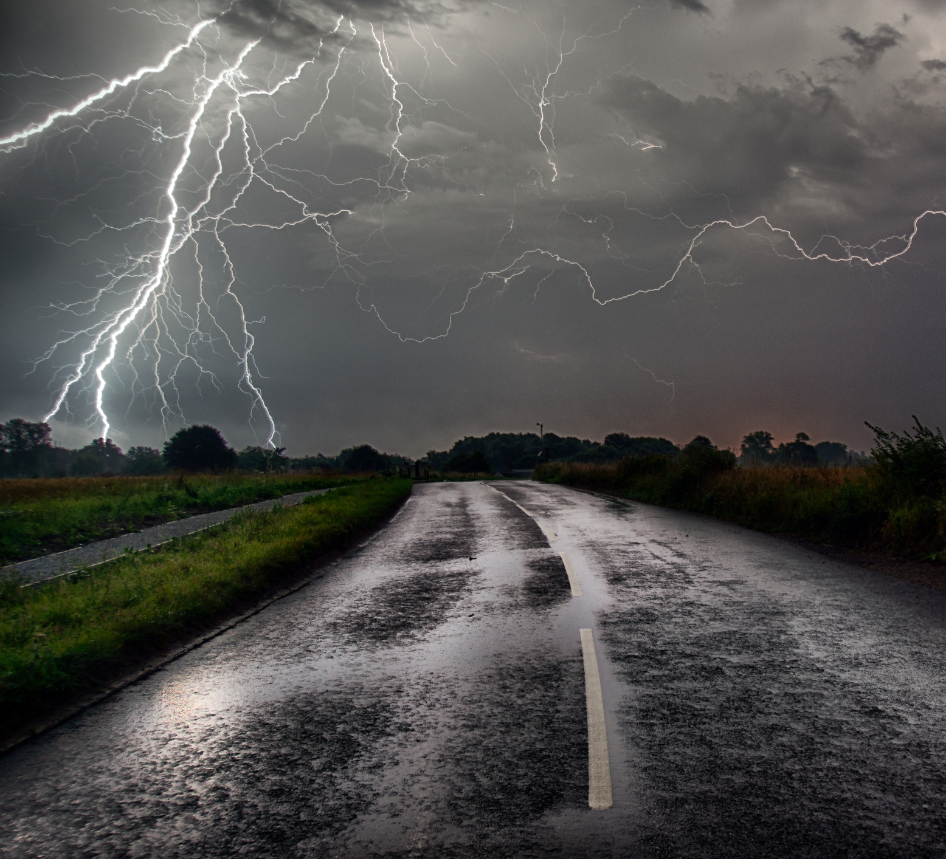
Thunderstorms
Usually, tornadoes spin off of severe thunderstorms.

Slide 11
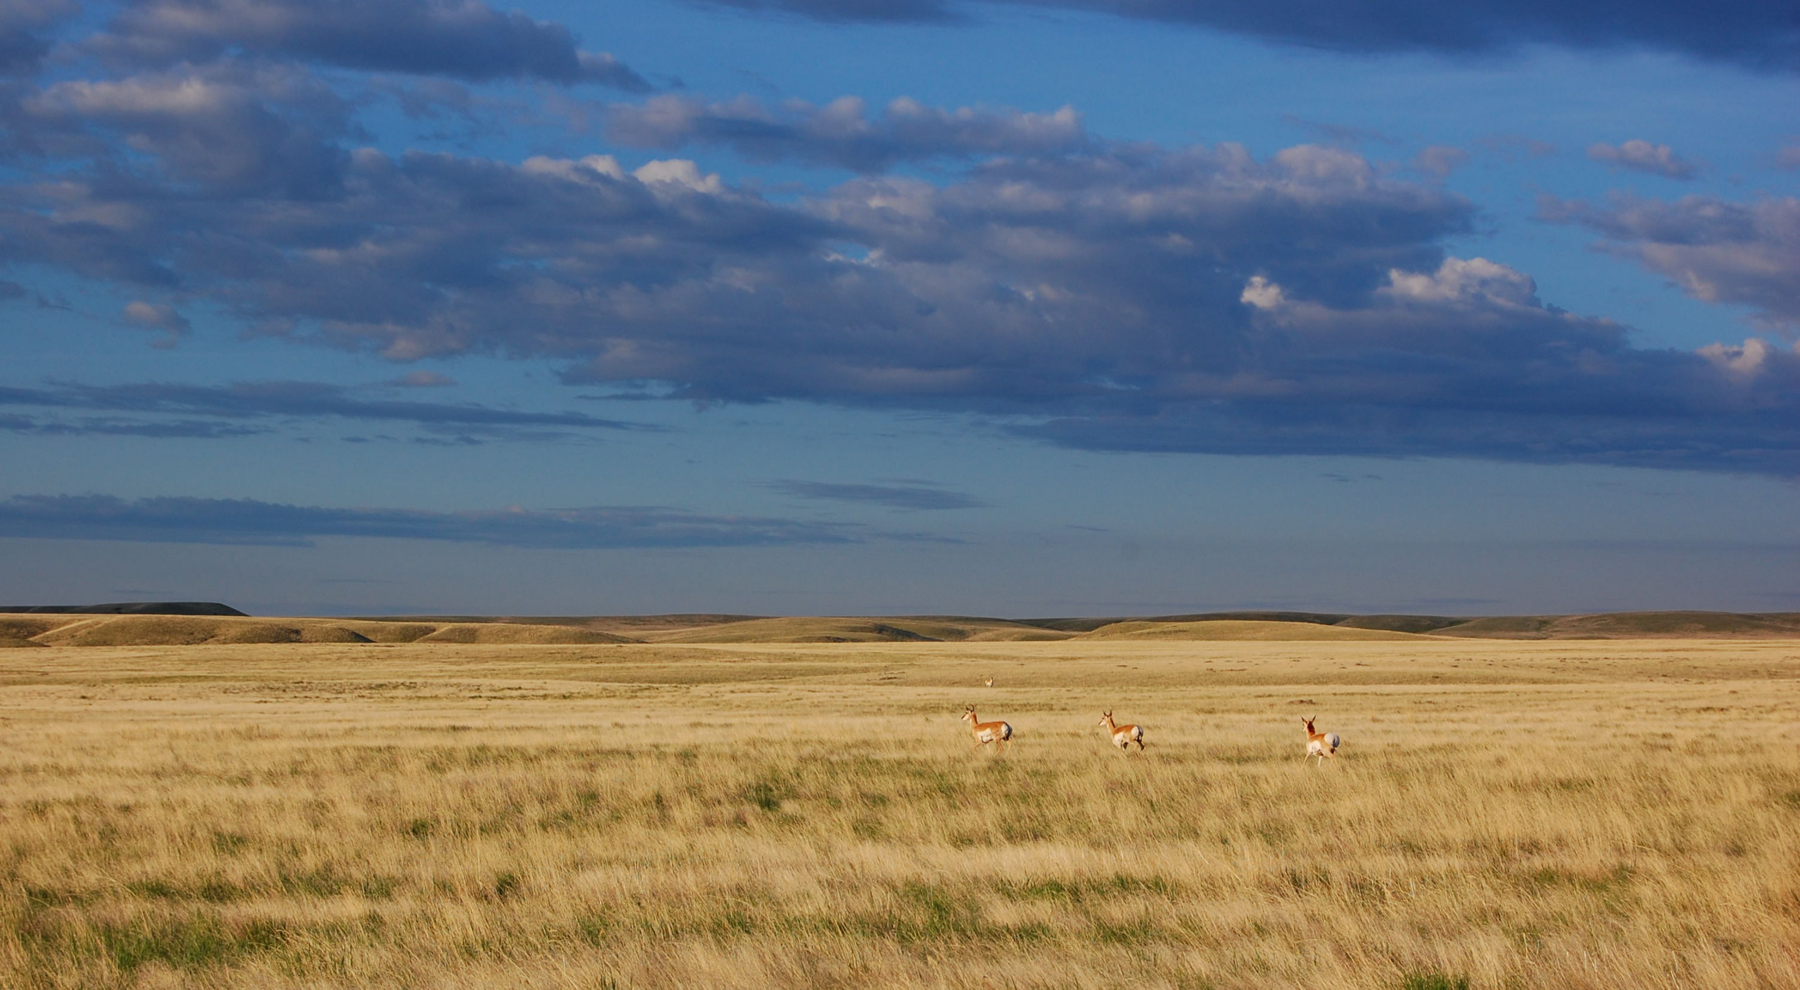
Great Plains
Tornadoes are common in the Great Plains region of the United States.

Slide 12
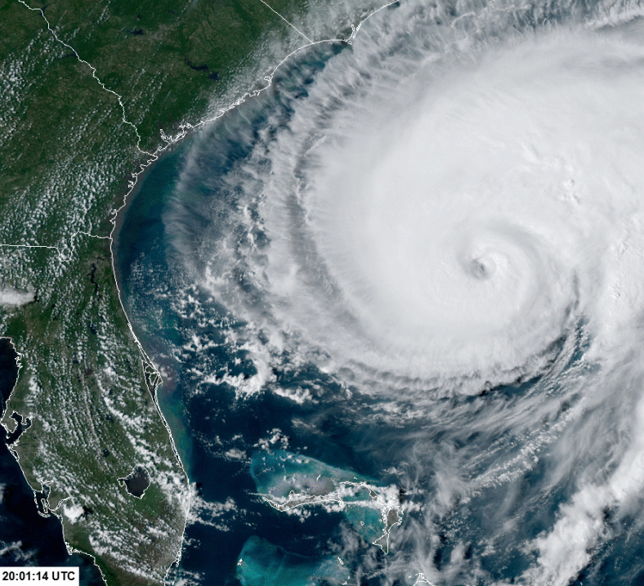
Hurricanes
A swirling system of winds, huge walls of clouds, and pounding rain is called a hurricane.

Slide 13
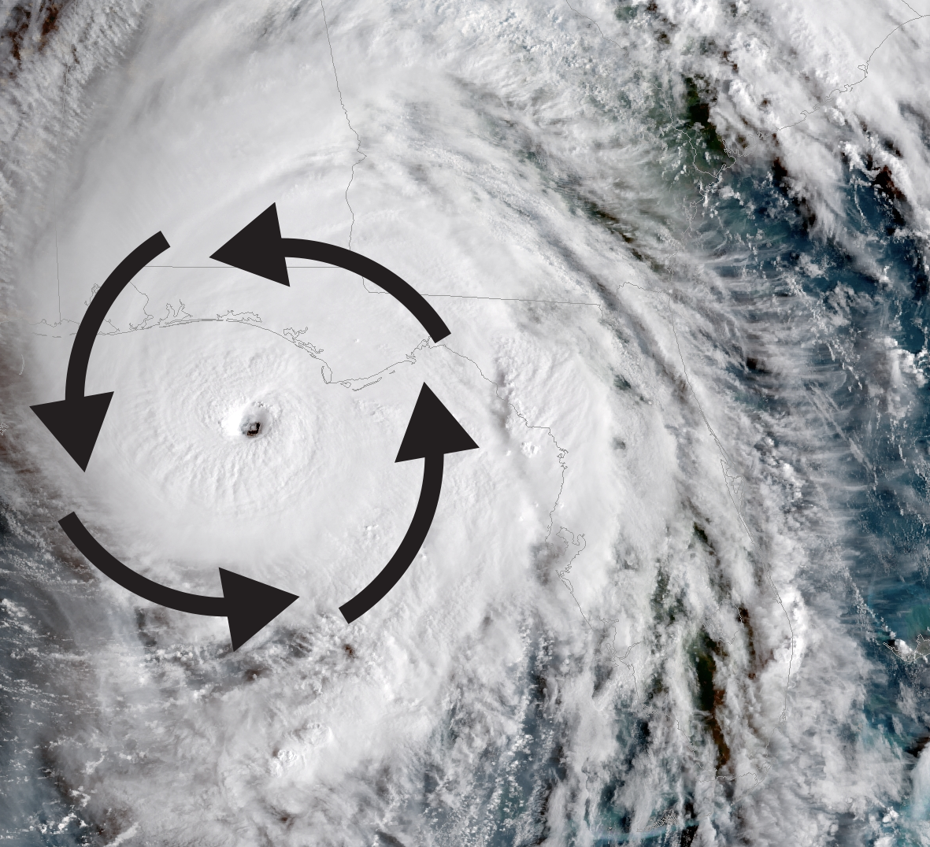
Hurricanes
Hurricanes form over warm oceans.

Slide 14
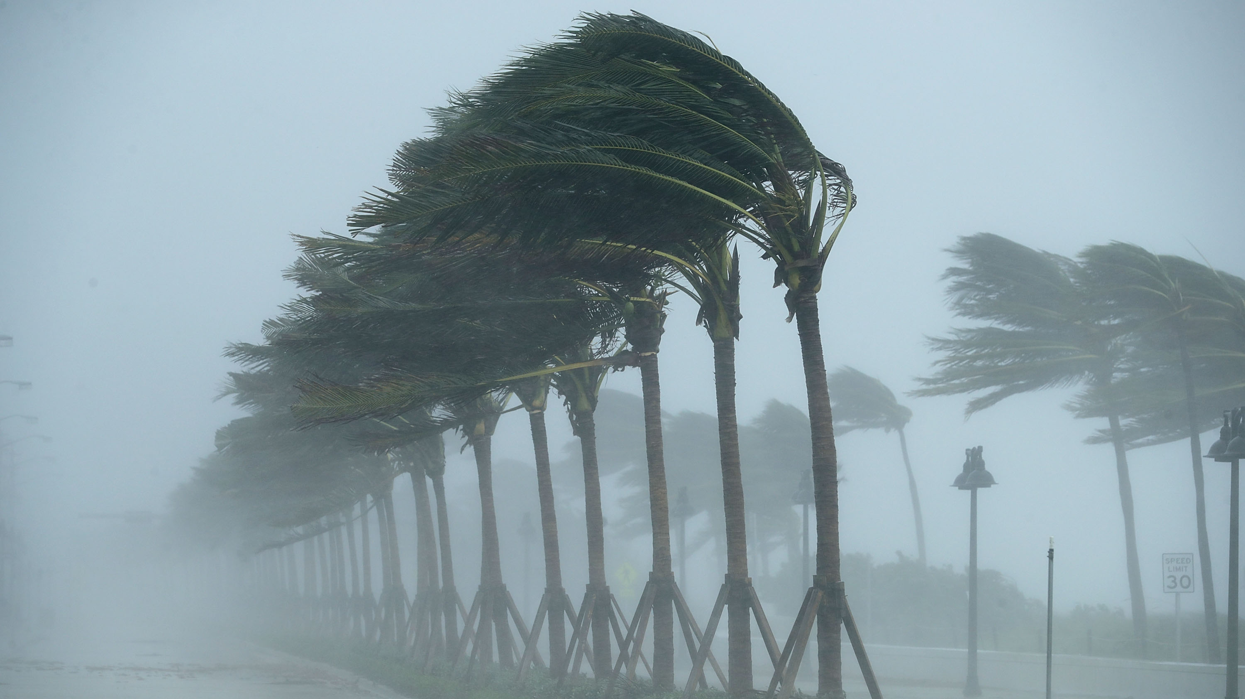
Hurricanes
Hurricanes are becoming more and more common in some places, possibly because of higher temperatures.

Slide 15
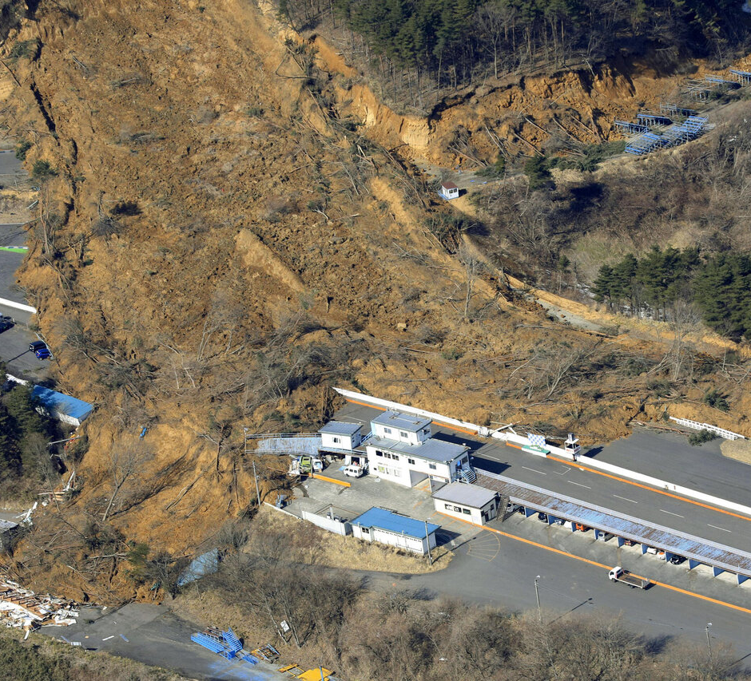
Landslide
Rocks and water-soaked soil move quickly down a hillside during a landslide.

Slide 16
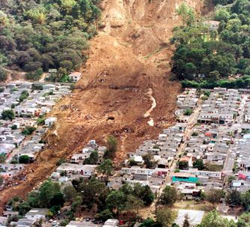
Gravity
A cause of landslides is gravity, which pulls rocks from high places to low places.

Slide 17
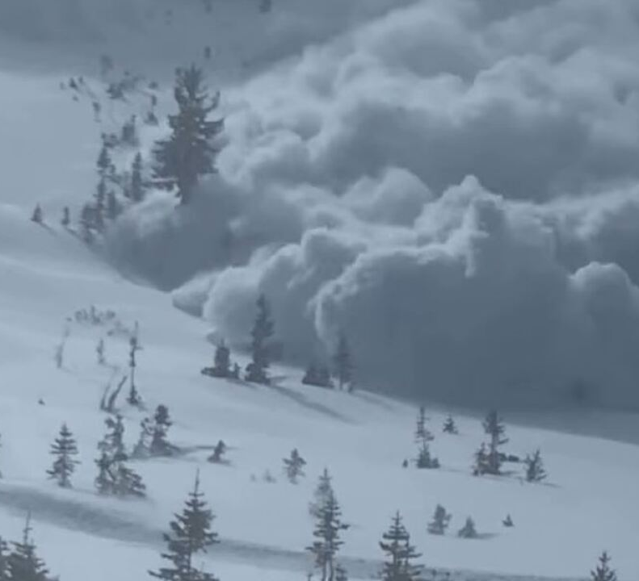
Avalanche
Tons of snow and ice move suddenly down a mountain during an avalanche.

Slide 18
Exit Question Critical Thinking
Write down your answer in sentence form.
Which do you think causes more damage to earth: too much water or not enough water?

Slide 19
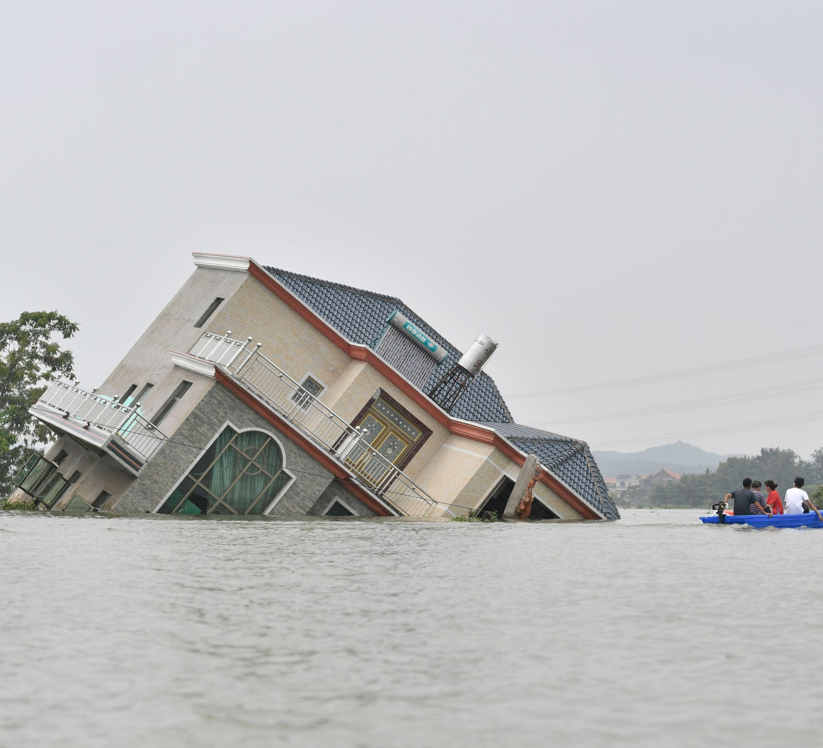
SHARING!!!
Too much water cause more damage due to flooding and landslides.

